Slide 1
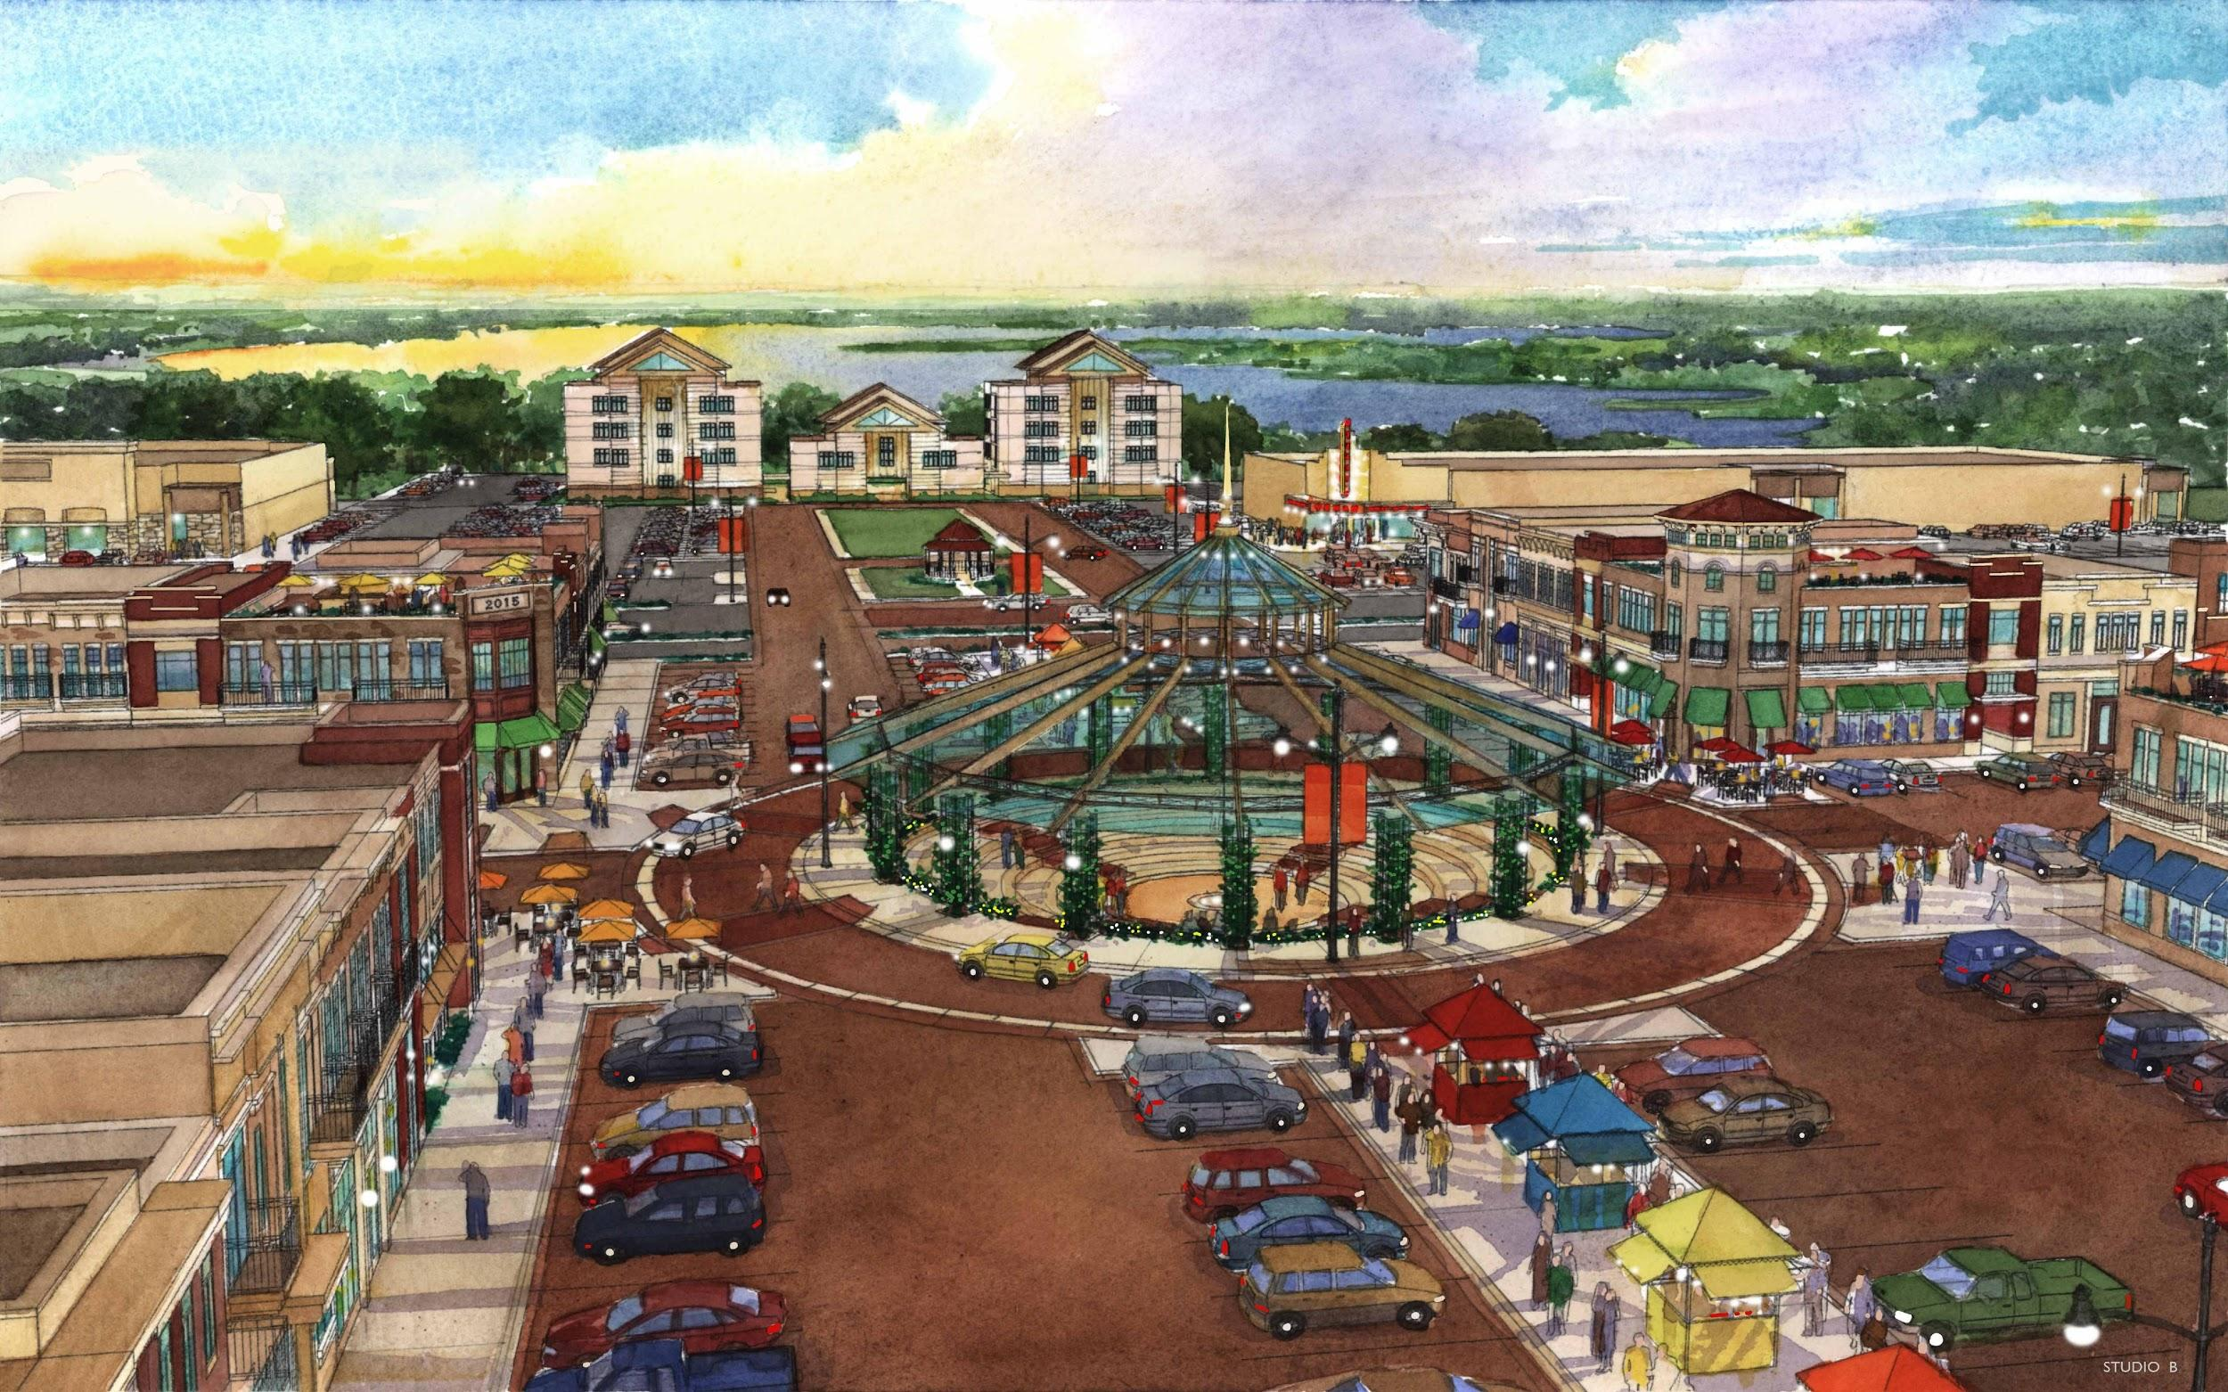
Lake Country Town Center
INFINITE VISION

Slide 2
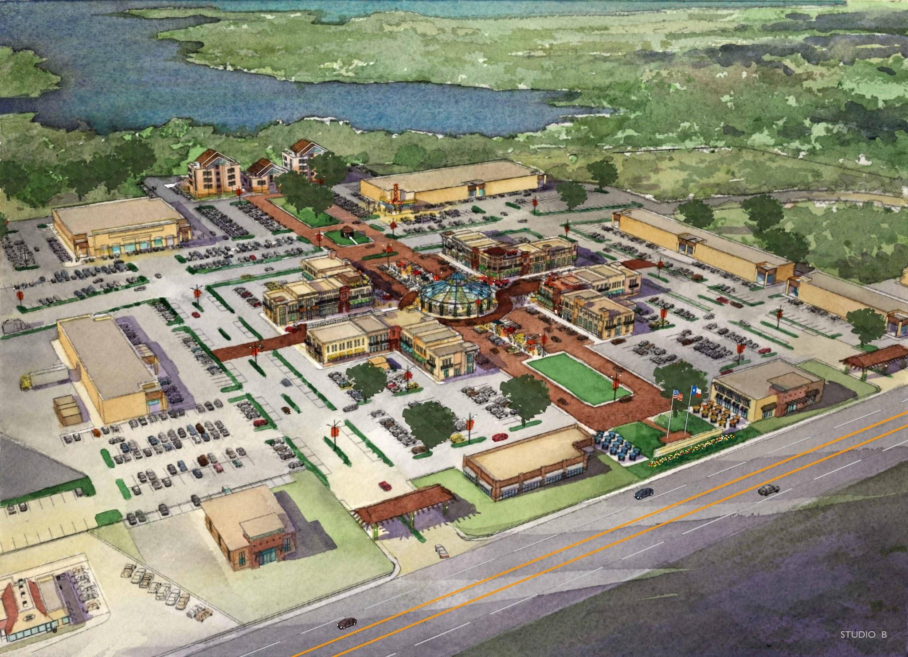
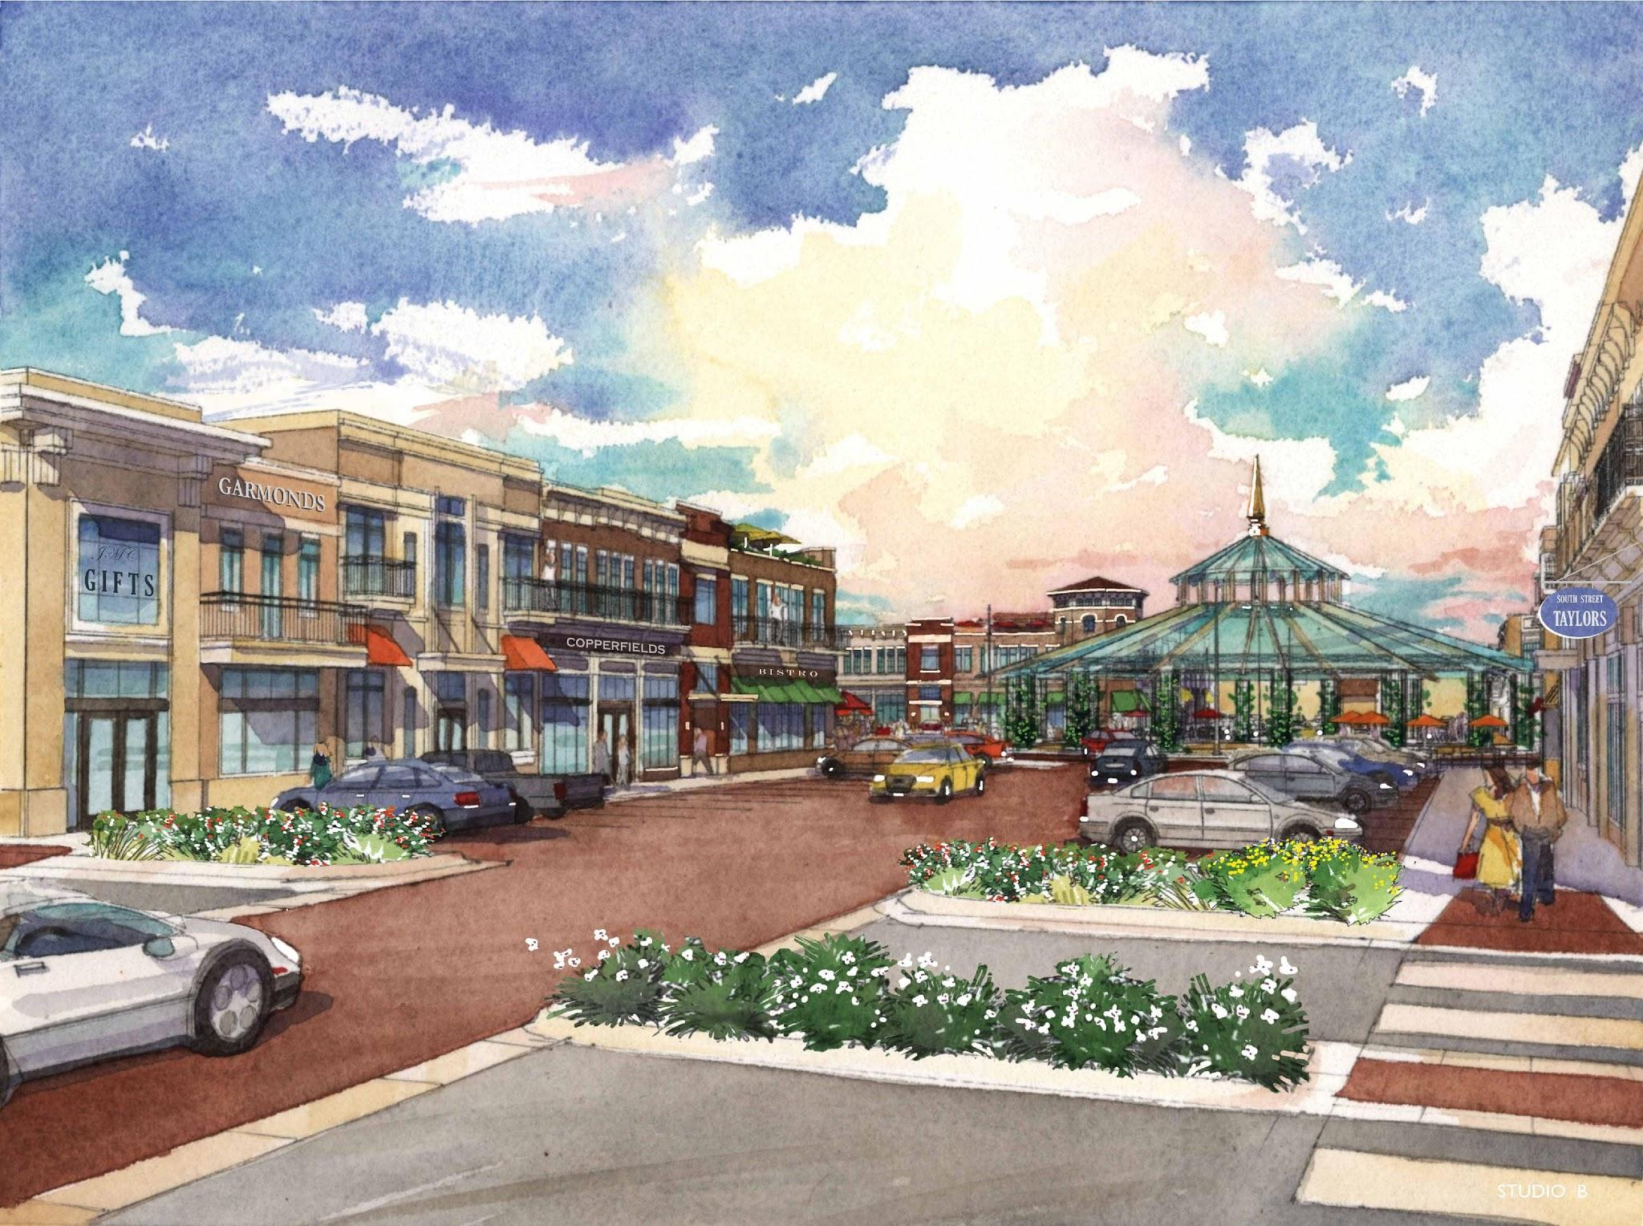
Renderings
INFINITE VISION

Slide 3
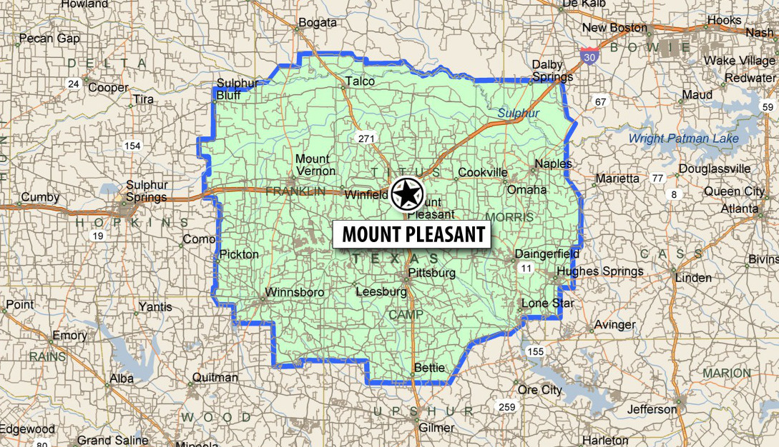
Retail Trade Area
INFINITE VISION

Slide 4
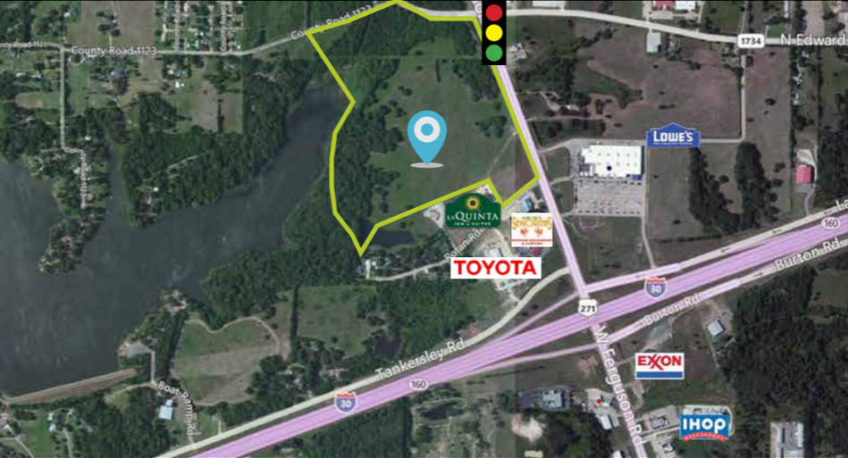
Site Information
Located at the northwest corner of I-30 and Highway 271.
Total acreage upon completion will be approximately 54 acres with 6 pad sites, multiple anchor pads, over 107,000 GLA and 40,500 residential rental units planned. Highway 271 was extended to be a loop around Mt. Pleasant in the fall of 2014.
The new loop has opened access to new trade areas that can be easily accessed by the new loop.
Traffic Counts:
Highway 271: 14,700 I-30: 25,000
INFINITE VISION

Slide 5
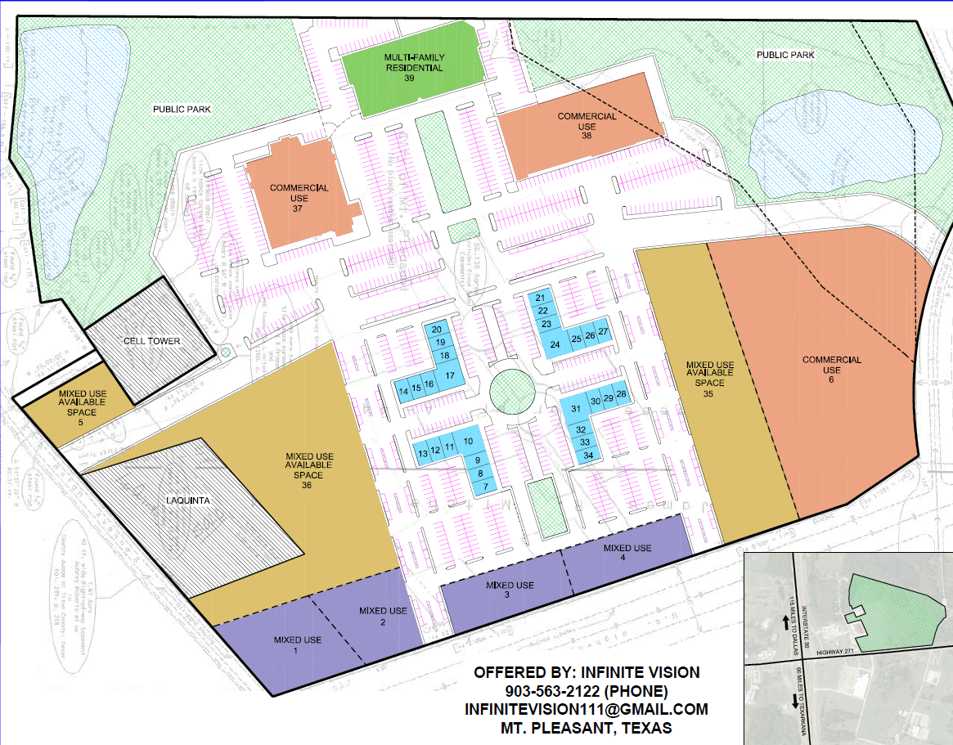
Site Development
Information
Project Acreage: 54 acres
Project GLA: 107,117 SF
Anchor Pads: 2 pads @ 88,700 SF
Pad Sites: 6 from ½ acre to 5 acres
Pad Prices: $6-$15 SF
Lease Rates Upon Request
Residential Space: 40,500 SF
Construction Start: Winter 2016
Phase 1 Delivery: Summer 2016
INFINITE VISION

Slide 6

Retail Trade Area
Property Highlights:
Shadow Anchored by Lowe’s
Only Regional Shopping Center within 30 miles
Within minutes of Regional Hospital
Located on I-30 and Highway 271 (Loop) 39,700 Traffic Counts
Demographics:
Population: 89,000
Average Income: $50,000/yr
Average Age: 36
Leakage Analysis Highlights: Grocery Store: $60,835,300
Restaurants: $60,403,530
Toys and Game Stores: $2,729,895
Miscellaneous Retail: $24,989,620
Drug Stores and Proprietary: $11,081,030
Radio, TV and Computer Stores: $43,682,360
Home Furniture and Furnishings: $10,927,950
Shoe Stores: $2,936,912
Drinking Places: $3,134,602
Used Merchandise: $2,537,178
Women’s Clothing and Accessory: $3,120,177
Traffic Generators:
INFINITE VISION

Slide 7
Trade Area Information
The Lake Country Town Center site is located at the North West corner of Interstate 30 and Highway 271 (the new loop around Mt. Pleasant) in the heart of the East Texas I-30 corridor that connects Dallas and Texarkana. It is one of the primary shopping, dining and hotel locations situated along the 2 ½ hour drive between the two cities.
The site will be an open air shopping center positioned 118 miles from Dallas and 63 miles from Texarkana. As the only regional shopping area within 30 miles, it offers an incredible secondary market opportunity, allowing retailers to have a presence in a market that currently services 90,000+ residents with a gap leakage of $372,329,100.
Wal-Mart learned the secret of Mt. Pleasant’s prime location for the retail trade area decades ago after opening an original Wal-Mart store in the 1980’s. Wal-Mart was so successful in this location that they chose to open their first Texas Supercenter in Mt. Pleasant; to this day, it continues to generate top sales for the state.
Even with Wal-Mart’s great success, the trade area has large spending leaks based on Retail Coach’s study that shows regional shoppers are driving long distances for these missing product options in mid-size cities. The leaks are being absorbed in trade areas that are 45-90 minutes away in Longview, Tyler, and Texarkana.
Dallas, 90 minutes away, is the closest large city for these regional shoppers to buy at.
Lake Country Town Center will open a venue for other regional and national retailers to absorb these retail leaks, while the regional shoppers will enjoy the new grocery store, movie theatre and other anchor sites planned for the center. The 200 plus seat amphitheatre will host events that will bring the city and regional shoppers in to enjoy the ambiance, amenities and shopping options that they have long waited to finally be conveniently located for them.
Lake Country Town Center is working on opportunities with potential anchors now for the development and will be making them public as they are solidified.
INFINITE VISION

Slide 8
Market Data Summary
The Lake Country Town Center trade area population is 90,000 with an average income of $50,000. Retail Coach provided a study of the trade area showing potential sales at $717,329,000.
The regional population has been driven to Mt. Pleasant because of the traffic flow brought by the Interstate and regional highways that provide access to many neighboring small towns. Total traffic counts between the access roads for the Town Center are almost 40,000 per day.
As time has passed the city has become an attraction because of other regional services such as North East Texas Community College (NETCC) and Industrial School as well as the Titus Regional Medical Hospital (TRMH) that is within minutes of the Lake Country Town Center.
TRMH celebrated 60 years of service this year. With 643 personnel on staff they serviced 66,334 patients in 2014. The hospital is located one exit down from the Town Center location and is one of the larger immediate traffic drivers in the area.
Other major employers in the area are within minutes of the location providing a stable daytime population including Mt. Pleasant ISD (3200 employees) that houses the bulk of their staff at the administration offices and high school around the corner from the Lakeside Plaza location. For more information about this project contact:
Jon & Tanya Anderson 903.563.2122 or 903.285.7631
Gavin & Minka Boyd 512.989.5973 or 512.662.3817
Project Email: infinitevision111@gmail.com
INFINITE VISION

